Slide 1
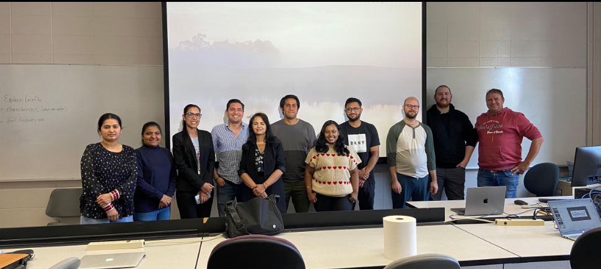

SAIT AI Solutions Club
Austin
Braden
Doug
Jorge
Juan
Notes:
""Climate change is a critical challenge today, primarily driven by CO₂ emissions. Each year, we release billions of tonnes of CO₂, worsening global warming.
At the SAIT AI Club, we are exploring how artificial intelligence can revolutionize carbon management. AI offers innovative solutions that can significantly reduce our carbon footprint.

Slide 2
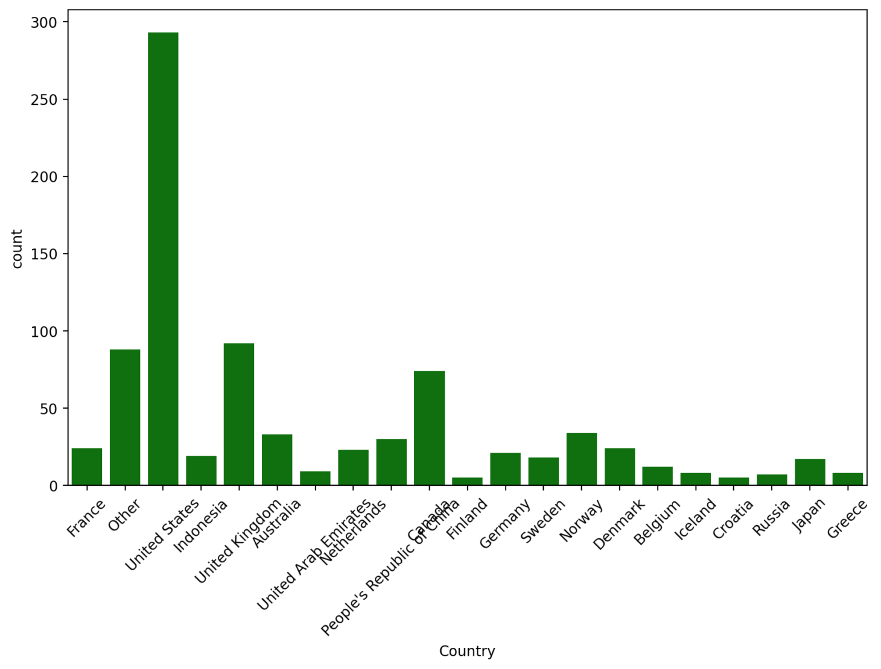
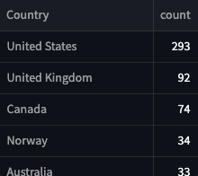
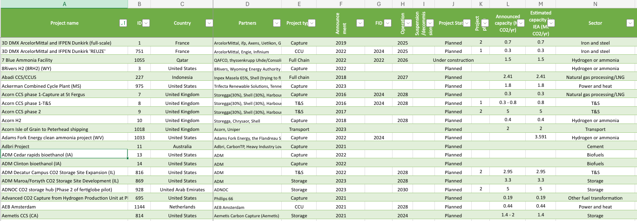
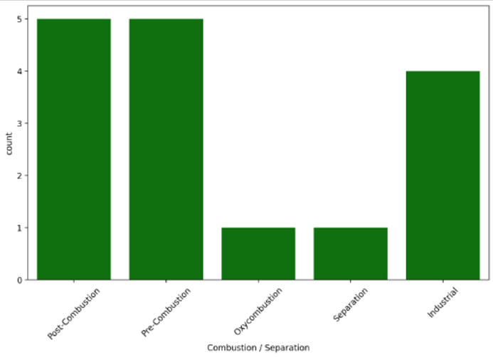
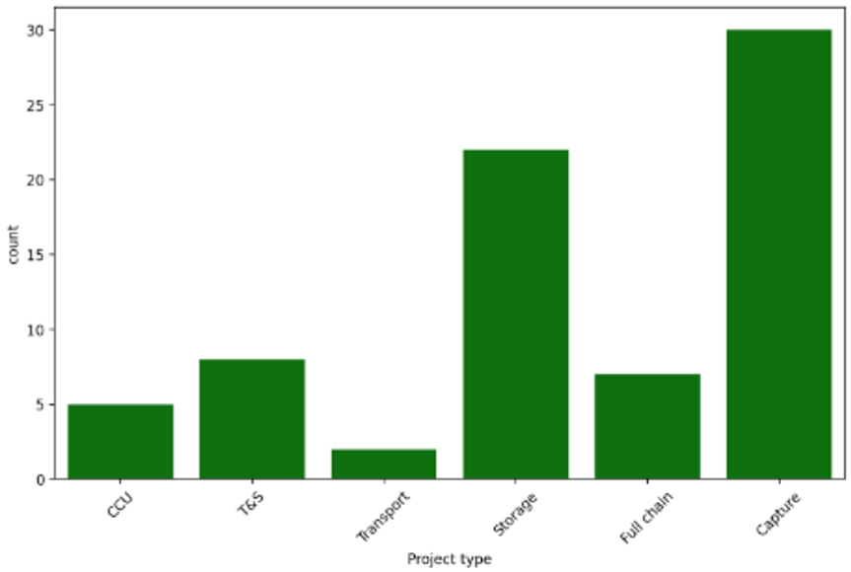
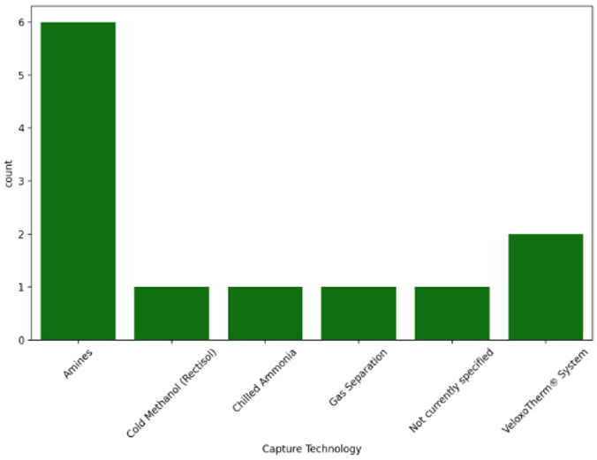
CO2 in Canada
Key Features
Project Information: Overview of CCS projects, including names, companies, and plant details.
Storage vs. Capture: Differentiation between CO2 capture-only projects and those also involving storage.
Geographical Distribution: Locations of projects across different countries and regions.
Project Phases and Status: Analysis of projects by phase (e.g., operational, planning) and current status.
Scope and Scale: Classification of projects by national or international scope, including technological focus.
Notes:
After analyzing over 50 datasets, we found that Canada ranks third globally in Carbon Capture, Utilization, and Storage (CCUS) with 74 completed projects. While pre- and post-combustion separation techniques seem similar, capture projects lead the way, with storage close behind. However, there are few full-chain solutions, highlighting a significant opportunity for our team to develop comprehensive projects.

Slide 3
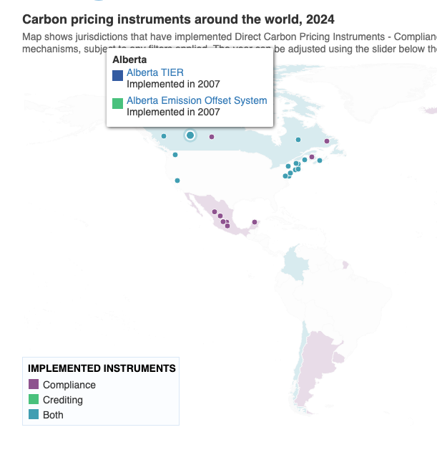
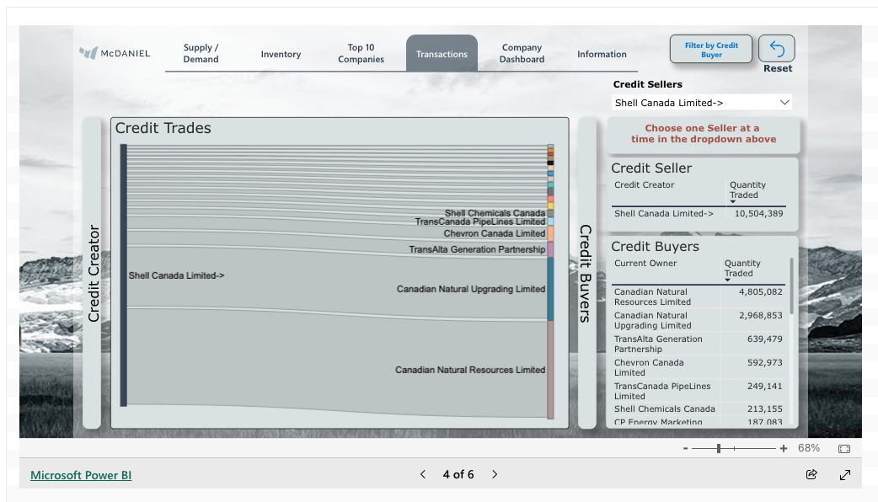
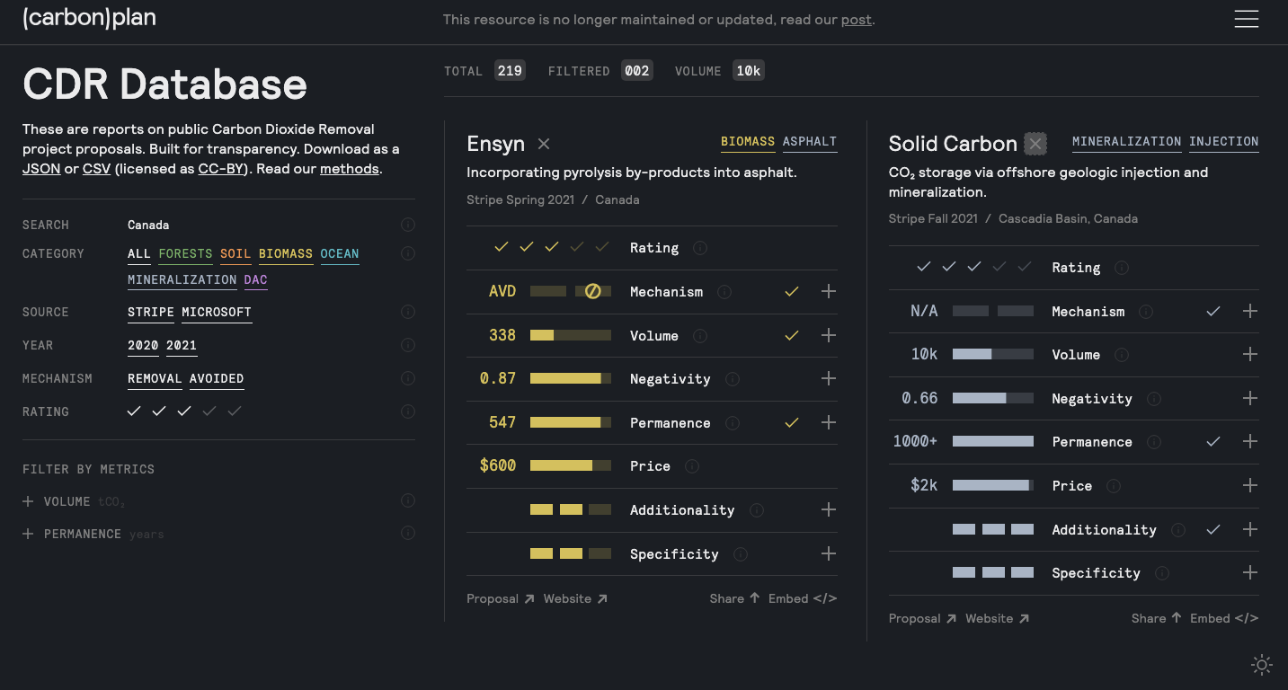
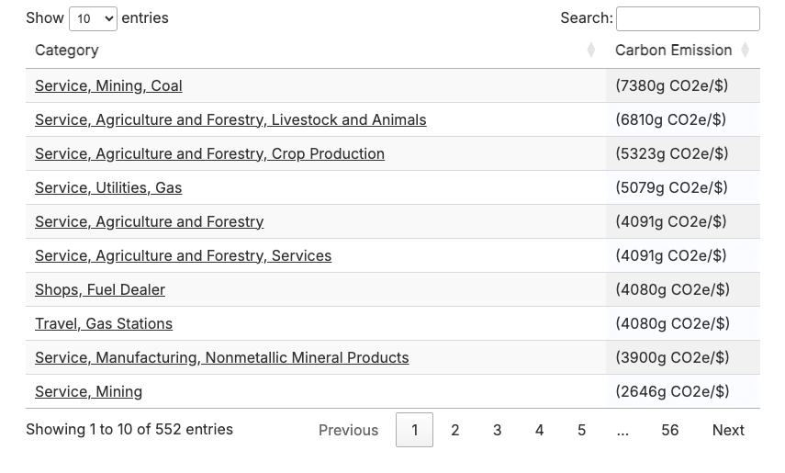
Which credits, types, benefits, taxes?
CO2 in Canada
Is there a real time updated CO2
trade platform?
How much does CCUS cost per unit of emission?
Which companies are in the game?
Alberta Carbon Market
…
Notes:
"After those insights, We know now that our responsibility must be addressed from various perspectives. As the primary objective is to propose a feasible implementation tool grounded in economic interests and market trends, considering compliance aspects such as tax incentives. We also aim to identifyt he business environentn, analysing for potential competitors or partners who could facilitate our development.

Slide 4
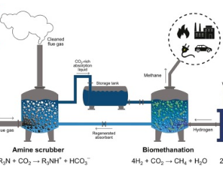
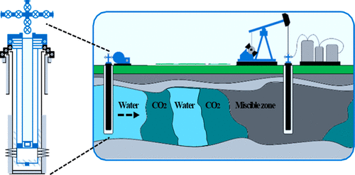
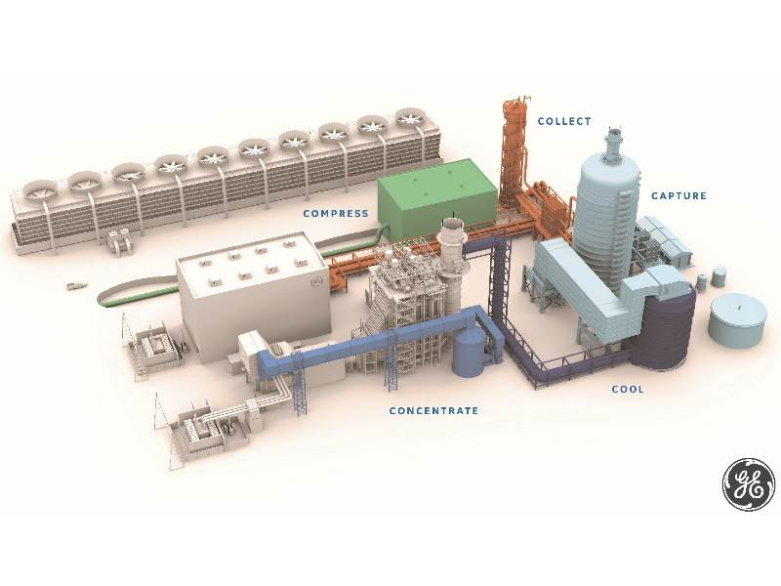
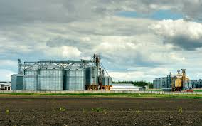
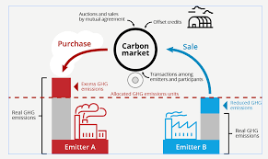
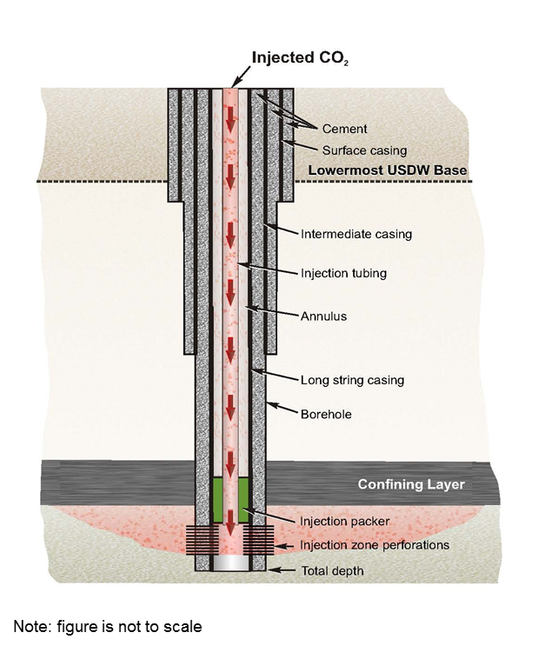
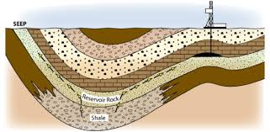
Nodal Analysis
Notes:
The oil and gas supply chain involves exploration and production, refining crude oil into products like gasoline, and distribution to customers. Node analysis plays a vital role by enabling CO2 emissions reduction.

Slide 5
1. Measure
2. Reduce
3. Reuse
RL for CO 2 removal from Flue Gas
Value Creation in transformation
Digital Twin and ANN for Energy Efficiency and Decarbonization
Reinforcement Learning for reservoir análisis and optimal quantification
AI for CO₂ Solubility Trapping Processes for Improved Storage Capacity
Notes:
It will be intriguing to see which organization first develops a fully integrated artificial intelligence solution for the oil and gas industry. This solution should utilize machine learning algorithms across all modules, focusing on improving and training these systems to effectively measure, reduce, and reuse CO₂. We are excited to get into it!

Slide 6
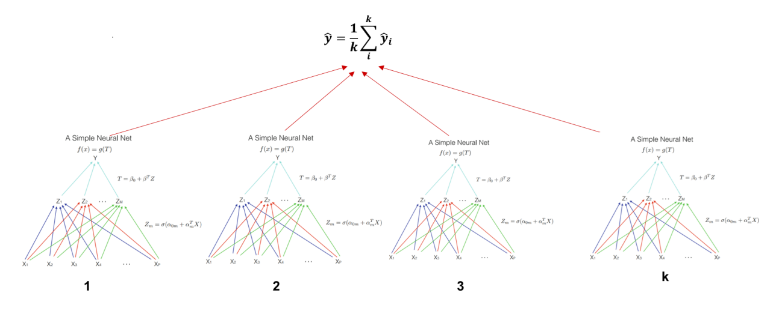
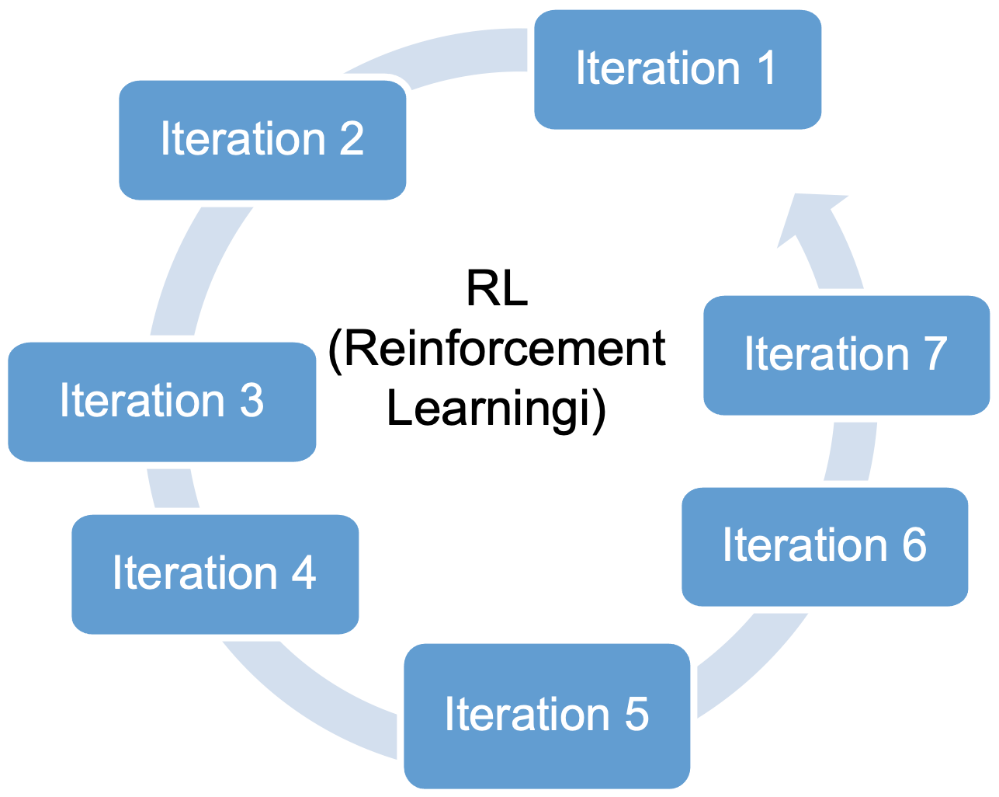
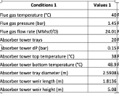
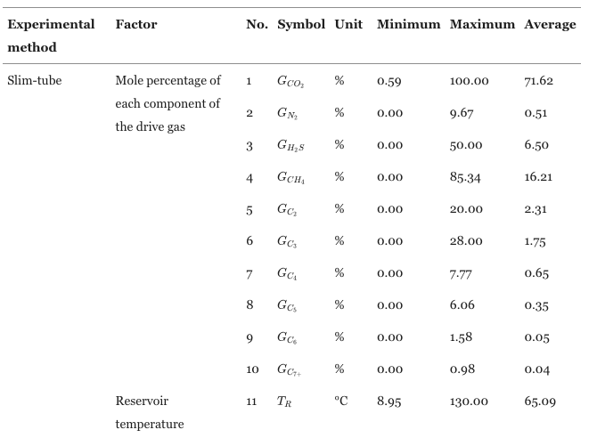
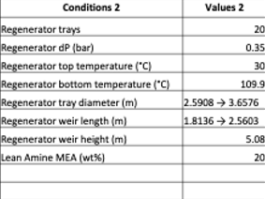
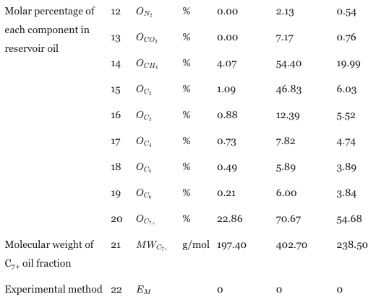
Measure
RL for CO 2 removal from Flue Gas
Reinforcement Learning for reservoir análisis and optimal quantification
Benefits
RL for CO 2 removal from Flue Gas
Execution Time: RL predicts under 1 millisecond.
Model-Free Algorithm: Learns from experience using data.
Fluid Composition Measurement: Matches live oil density accurately.
Real-Time Phase Envelopes: Optimizes pumpout speed in real-time.
Reinforcement Learning for reservoir análisis and optimal quantification
AI-optimized carbon capture increases efficiency, reducing CO₂ emissions significantly.
Reinforcement learning optimizes energy use, decreasing fossil fuel consumption and emissions.
Predictive analytics prevent equipment failures, ensuring operational efficiency and lower emissions.
Neural network ensemble regression model - Multivariate optical computing (MOC)
Reinforcement learning - Deep Deterministic Policy Gradient (DDPG) algorithm
Notes:
We’re using Reinforcement Learning (RL) to optimize CO2 removal from flue gas and employing the Deep Deterministic Policy Gradient (DDPG) algorithm, we significantly reduce operating energy costs in over 70% of scenarios while enhancing CO2 removal.
Additionally, Multivariate Optical Computing (MOC) allows for better estimation of subsurface CO2 composition, optimizing facility design and improving capture efficiency.

Slide 7
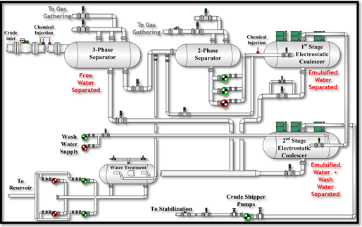
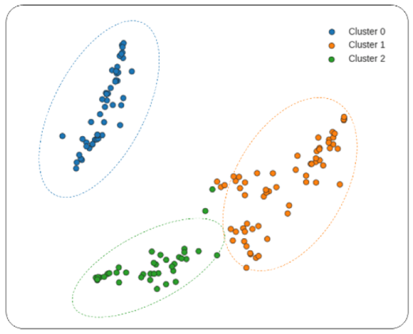
2. Reduce
Enhancing Digital Twin Accuracy for Energy Efficiency and Decarbonization
Benefits
Improved Asset Performance and Anomaly Detection: Early anomaly detection can reduce energy wastage by up to 10%, leading to an estimated 5-8% reduction in CO2 emissions by optimizing equipment performance.
Enhanced Operational Efficiency: By minimizing downtime and optimizing maintenance, operational energy efficiency can improve by 15-20%, potentially lowering CO2 emissions by 10-15% across operations.
Optimized Resource Allocation: Efficient production allocation at Gas Oil Separation Plants (GOSPs) could reduce energy consumption by 10-12%, contributing to a CO2 emission reduction of 8-10%, depending on the scale of operations.
Digital twin. Big data utilizing a multi-node architecture. Clustering technique. Production Optimization Models are employed as part of Predictive Analytic Models and Mixed Integer Non-Linear Programming Models
Parameter | Value
Flow | 80 to 120 units (e.g., m³/h)
Level | 70 to 90% of full capacity
Pressure | 130 to 170 psi (9 to 11.7 bar)
Temperature | 180 to 220 °F (82 to 104 °C)
Vibration | 0.3 to 0.7 in/s
Bearing Temperature | 45 to 55 °C (113 to 131 °F)
Lube Oil Temperature | 55 to 65 °C (131 to 149 °F)
Surge Limit | 0.75 to 0.85 (ratio or %)
Pump Performance | 70 to 80% efficiency
Compressor Curve | 0.85 to 0.95 (coefficient of performance)
Failure Risk | 0.2 to 0.8 (lower values indicate lower risk)
Notes:
Digital Twin technology, combined with Big Data creates real-time smart decisions.
By leveraging a Clustering Technique, we can group assets based on their similarities, regardless of the manufacturer. These clusters fuel Predictive Analytic Models, which enable early anomaly detection that combined with reducing energy wastage by up to 10% and cutting CO₂ emissions by 5-8%.

Slide 8
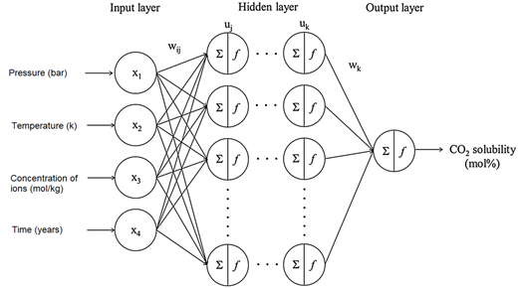
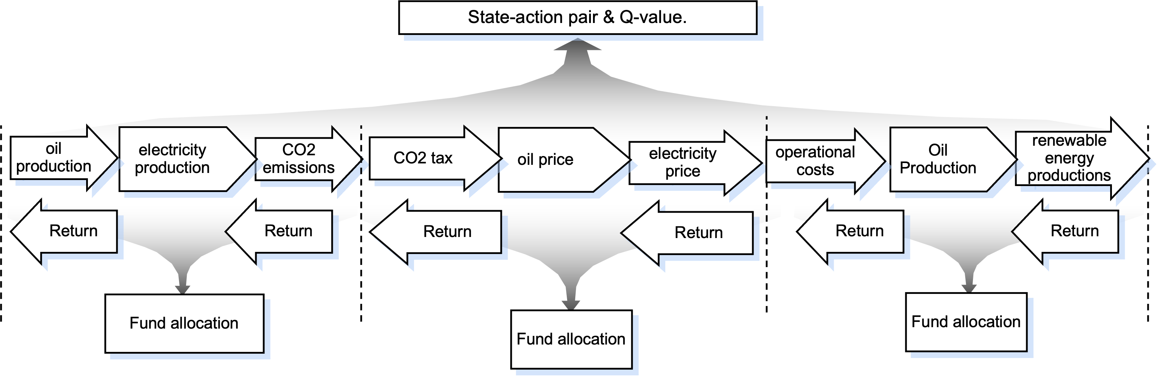
3. Reuse
AI for CO₂ Solubility Trapping Processes for Improved Storage Capacity
Value Creation in transformation
Benefits
CO2 solubility
Increased Storage Capacity
Improved Efficiency
Reduced Environmental Impact
Value creation:
Holistic Decision-Making: Converts CO2 emissions into monetary terms (e.g., $50/ton of CO2)
Risk Management: Optimizes renewable energy investments, potentially reducing emissions by 20-30%.
Sustainability and Profitability Alignment: Aims for 15-25% emission reduction while maintaining NPV growth
ANN - multi-layer perceptron (MLP)
Reinforcement learning
Parameter | Value
Oil Production | 1000 to 5000 barrels/day
Electricity Production | 500 to 2000 MWh/day
CO2 Emissions | 0 to 1000 tons/day
CO2 Tax | $0 to $100 per ton
Oil Price | $40 to $100 per barrel
Electricity Price | $20 to $80 per MWh
Operational Costs | $5000 to $20000 per day
Renewable Energy Production | 100 to 1500 MWh/day
Notes:
Identifyng optimal storage locations and adapt injection strategies in resrvoirs is key, we aim to increase storage capacity and improve efficiency while minimizing energy consumption and costs.
Additionally, by integrating value creation into these processes, we can transform CO₂ emissions into economic gains, potentially generating $50 per ton of CO₂. This holistic approach aims for a 15-25% reduction in emissions while promoting profitability. Furthermore, our AI system supports risk management, which could lead to an additional 20-30% reduction in emissions.

Slide 9
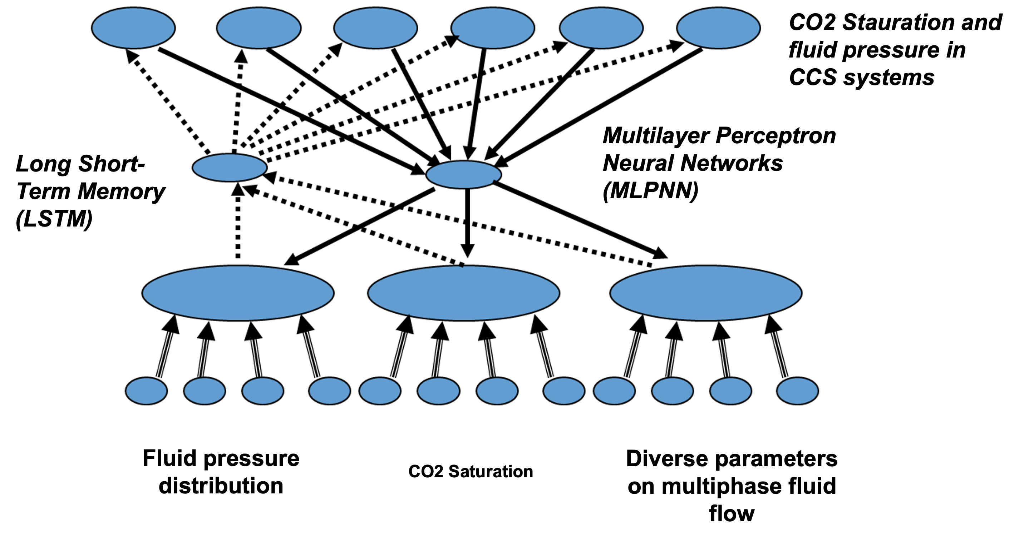
Proof of Concept (PoC)
Dataset
Feature analysis
= %
Results
Algorithm
upstream
midstream
downstream
Notes:
The proof of concept focused on feature analysis across operation nodes. After identifying key parameters, we selected the best algorithms for the data at each node. When real datasets were lacking, we used generative AI to simulate conditions. Our results highlighted the benefits of AI, providing quick wins and easy-to-follow steps for users across the industry value chain.

Slide 10
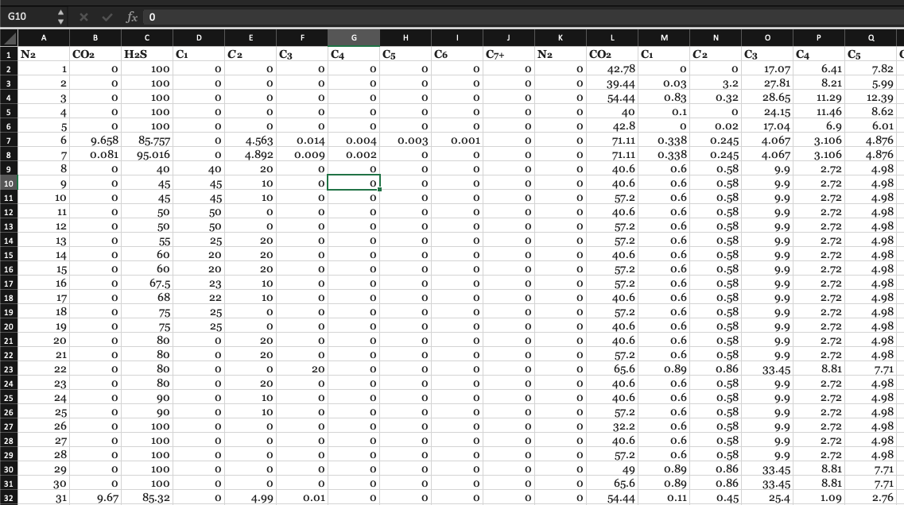
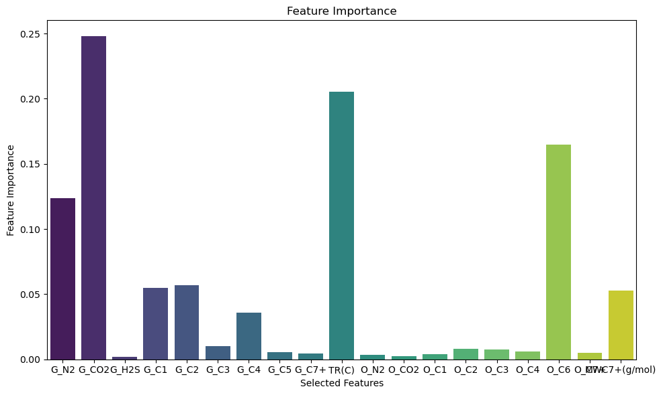
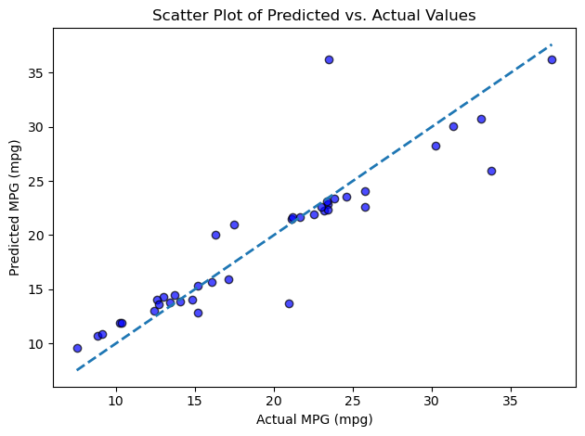
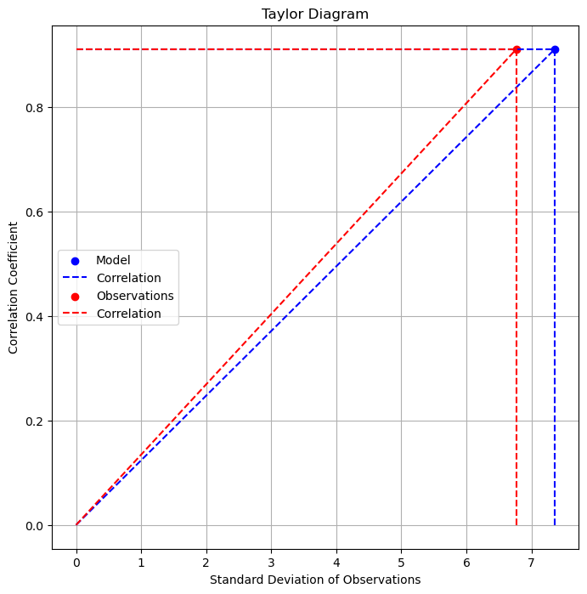
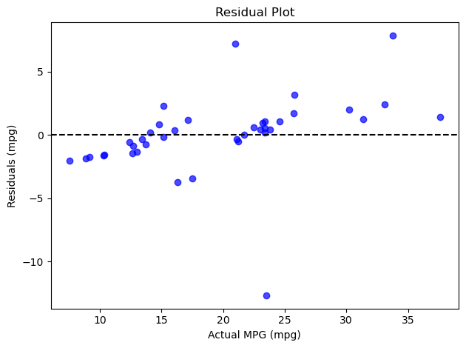
upstream
midstream
downstream
193 CO2-MMP measurements, test methods.
CO2 and oil component percentages.
Slim-tube or RBA test distinction.
C7+ molecular weight, reservoir temperature.
Collinearity minimized, CO2 excluded input.
Accurate measurement increase: 6% - CO2 emissions decrease (estimation): 11%
Notes:
This scatter plot demonstrates the model's effectiveness in predicting carbon emissions and operational efficiency in gas processing. The close alignment of predicted and actual values shows it captures key data relationships. s could save companies millions by avoiding carbon taxes and improving energy efficiency by 10-20%, offering a clear path to lower emissions and cut costs while enhancing profitability.

Slide 11
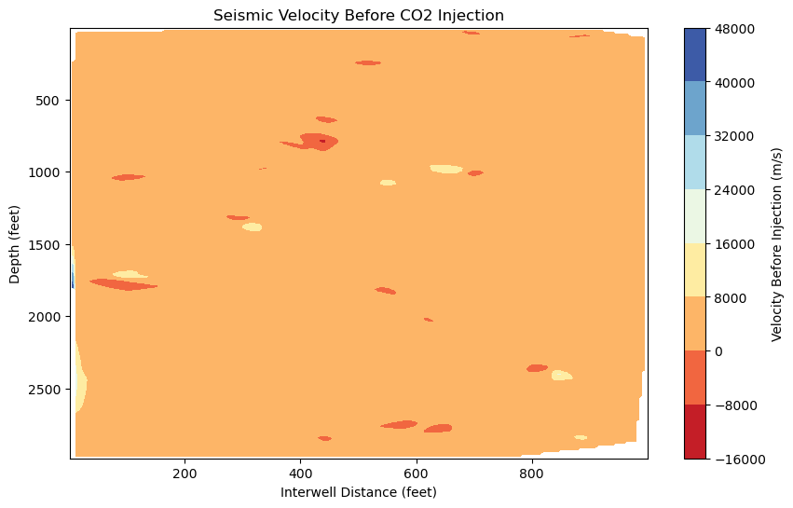
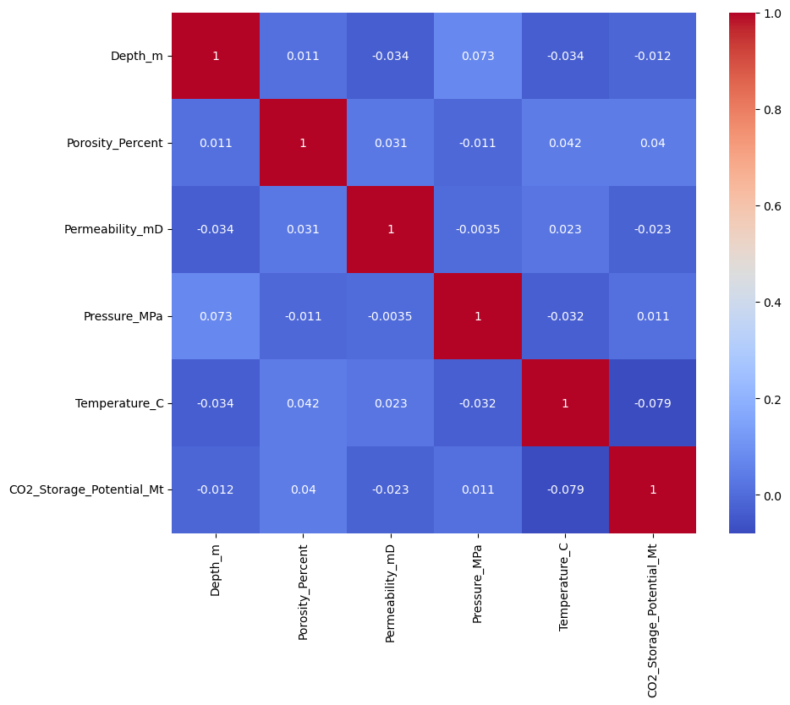
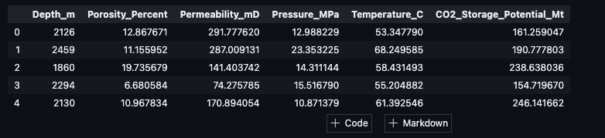
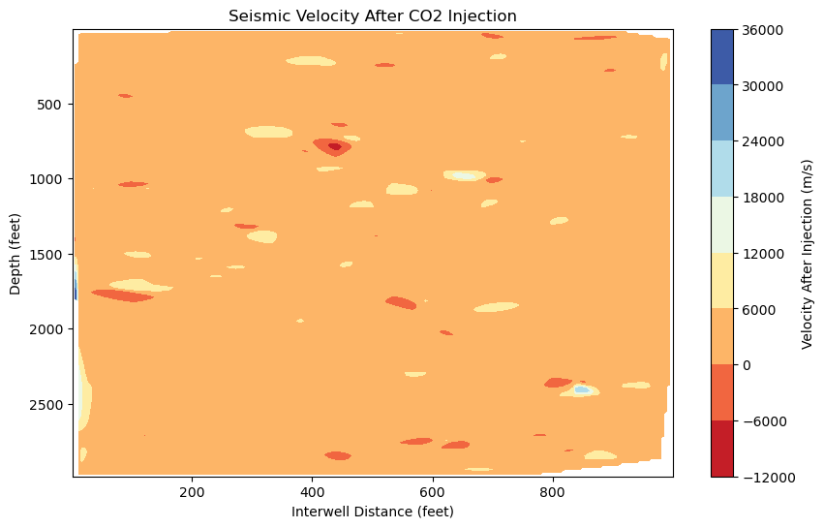
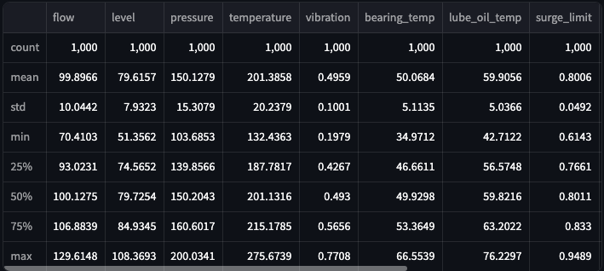
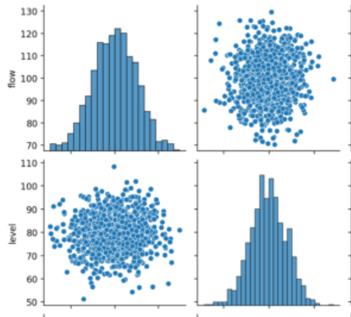
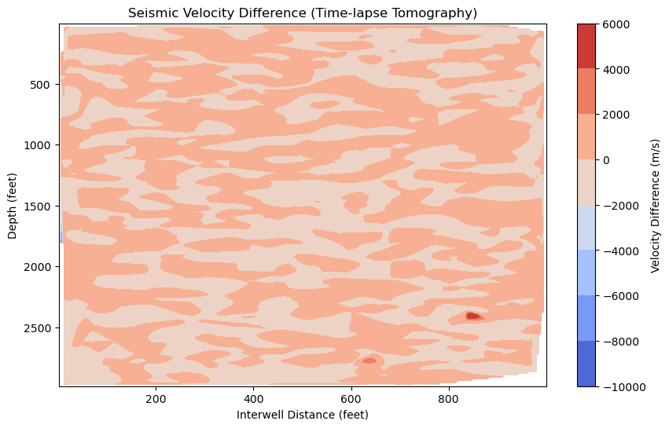
upstream
midstream
downstream
2 datasets: 1000 entries, generative AI to create synthetic information and patterns from real worlds applications.
The dataset is split into two subsets, one containing the seismic velocity before injection and another containing the velocity after injection.
5-8% reduction in CO2 emissions by optimizing equipment performance.
Notes:
The AI solution analyzes seismic velocity changes before and after CO₂ injection using time-lapse tomography. By examining interwell distance and seismic variations, we can track how CO₂ impacts the reservoir, identifying potential storage zones through lower seismic velocities. Combining this with operational data allows for optimized reservoir management and reduced failure risks. This predictive model could lead to an 8% reduction in short-term CO₂ emissions, cutting up to 1.2 million metric tons annually, saving $5-10 million by avoiding carbon taxes while enhancing energy efficiency and profitability.

Slide 12
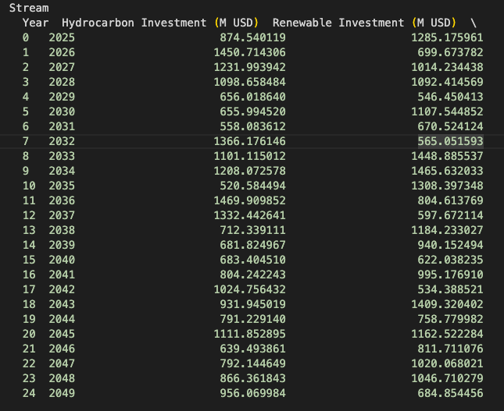
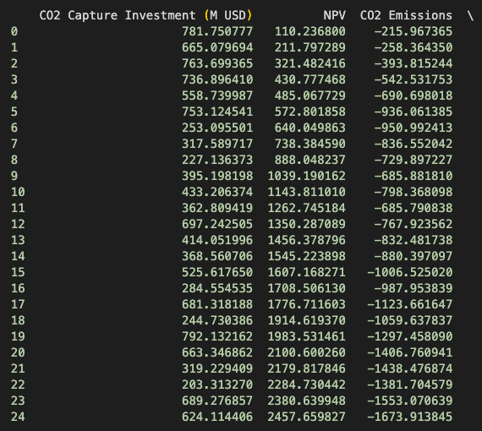
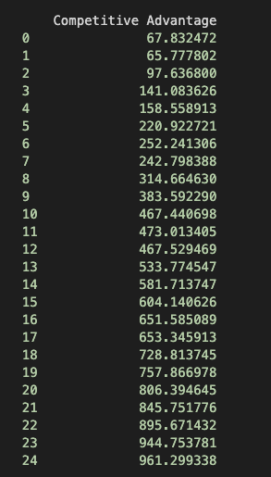
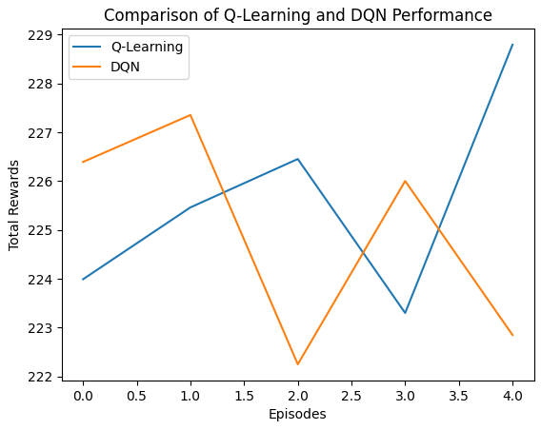
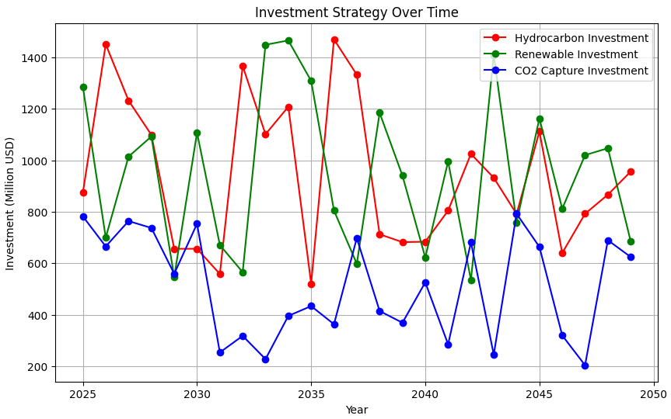
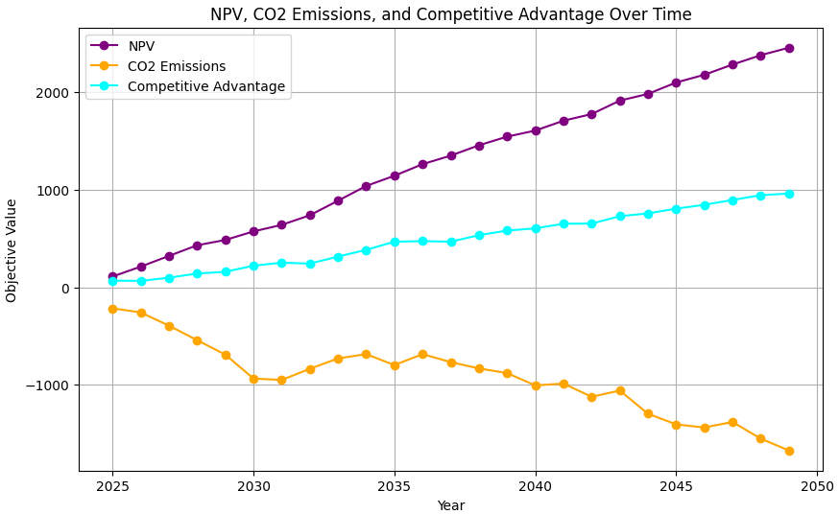
upstream
midstream
downstream
RL: 13.01 of reward scoring – CO2 secondary emissions reduced by 7%
Notes:
Downstream operation represent an opportunity to use Reinforcement Learning, Q-learning, and Deep Q Networks (DQN) to optimize investment decisions in oil & gas, renewable energy, and CO₂ storage. By simulating investment actions, we train the model to maximize rewards related to company performance and environmental compliance. The Q-learning algorithm continuously improves its strategy, while DQN allows for scalability as complexity increases. For example, a renewables-focused strategy can achieve up to a 7% CO₂ reduction. By optimizing investments, companies can reduce emissions, enhance profitability, and gain a competitive edge.

Slide 13

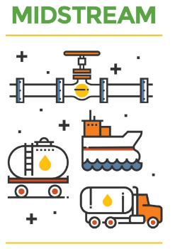
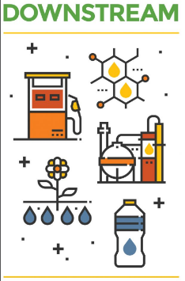
Value chain CO2 emissions reduction
Accurate measurement increase: 6% - CO2 emissions decrease: 11%
5-8% reduction in CO2 emissions by optimizing equipment performance.
RL: 13.01 of reward scoring – CO2 secondary emissions reduced by 7%
TOTAL: Aprox 20 – 25% of eficiente and feasible emissions reduction (proven in jurisdictions like Austraia, China, and US (Texas)
Notes:
By implementing generative AI in the oil and gas industry, we've achieved a 20-25% reduction in emissions, with 6% overall CO₂ reduction driven by optimized equipment performance. Our reinforcement learning model contributed an additional 7% decrease in secondary emissions. These efforts enhance our sustainability and operational efficiency, demonstrating that generative AI is crucial for a sustainable future, as proven in regions like Australia, China, and Texas.

Slide 14




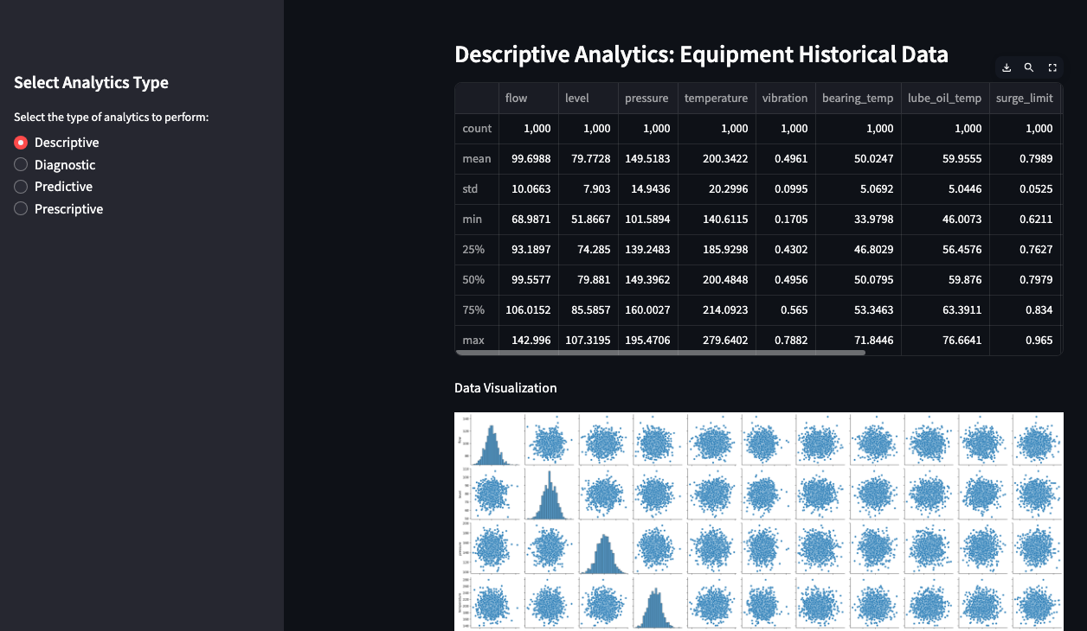

Web & Mobile app
Gen AI
Notes:
Recognizing that successful AI implementation requires strong leadership and change management, it’s equally important to provide an interface, and usable product. We want to introduce CaptureX—a web and mobile application that provides precise artificial intelligence based decisions. Our platform optimizes all stages of carbon capture, enabling significant emissions reductions while maximizing operational benefits.

Slide 15






KEY TO SUCCESS! Partners in implementation projects and pilots
Innovative development
Carbon Storage Monitoring
Connecting Solutions with End-Users
Newell County facility
Notes:
In closing, we’re excited about innovations at the Devon Research Centre, which hosts experts and focuses on reducing fossil fuel impacts through cutting-edge technology. At Carbon Management Canada’s Newell County Facility, we’re advancing greenhouse gas monitoring for safe CO2 storage. We are deeply excited to reshape the new framework for sustainability using AI to solve issues that impact the humanity for good and why not, to make a change in the history. THANK YOU!

